Slide 1

Introduction to Robotics ME 639: Industrial Project Presentation 2
Project Title: Join Impedance Control for an existing Exoskeleton
Team Name: Sophia humari BHI behn hai
Team Members: Anusheel K, Jaydeep K, Rwik Rana
Instructor: Prof. Harish PM
Teaching Assistant: Suraj Borate

Slide 2
Problem Statement:
“Model a 1-DOF Knee Joint -Shank Link rotational system for assist control utilizing impedance control methods.”
Industry name: Timetooth
Objectives:
A 100% torque assist from motor corresponds to zero patient effort for its own limb movement
A 0% torque assist from motor corresponds to full patient effort for its own limb movement. Assuming zero patient effort, deduce the motor torque identifying the subcomponents of exo link and human limb.
1

Slide 3
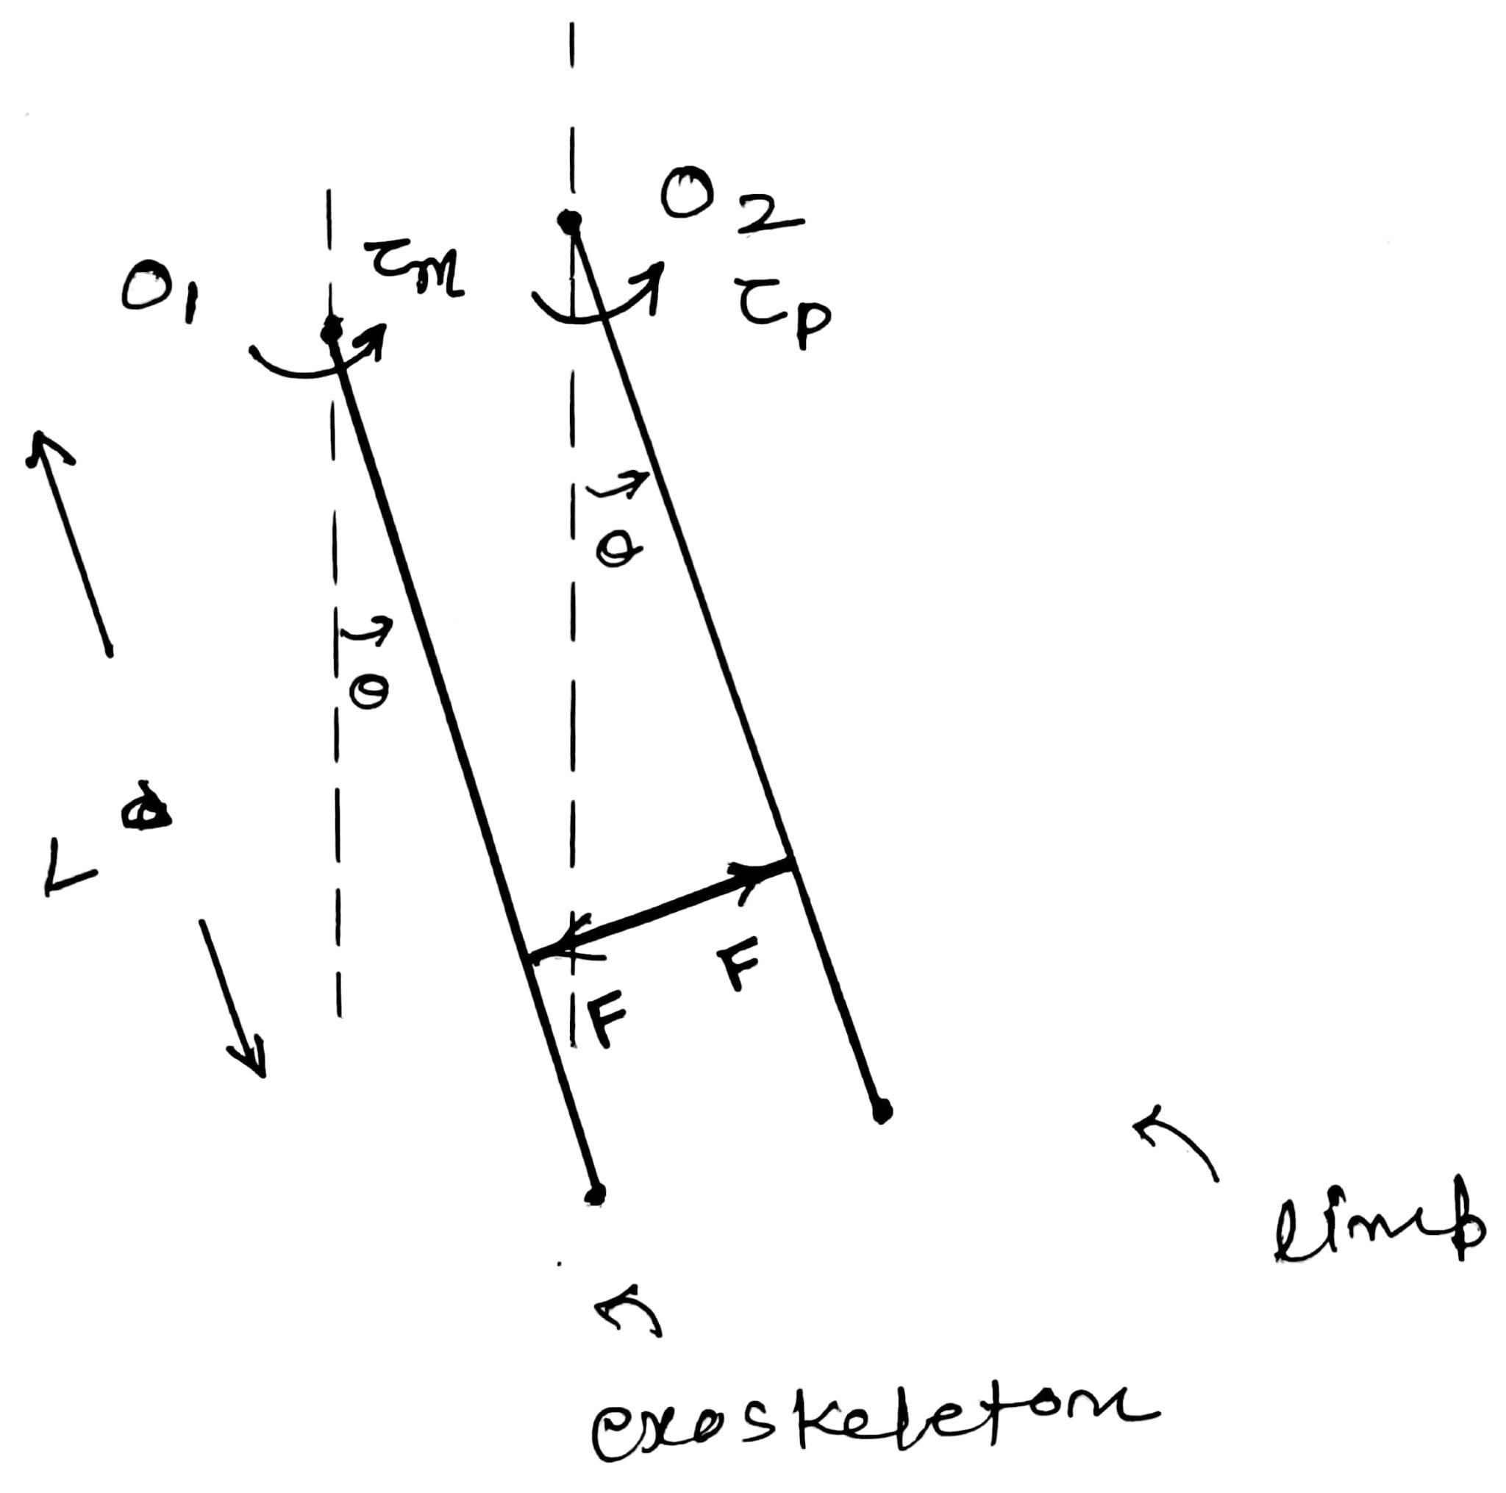
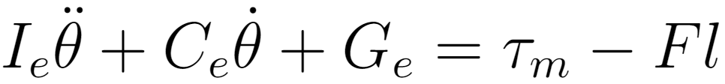
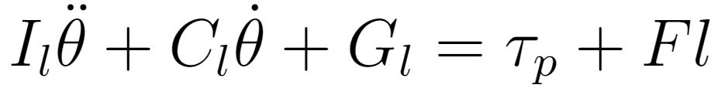
Rationale / Approach / Ideas:
Modelling 1-DOF Knee Joint -Shank Link System
As shown in figure, we can consider limb and exoskeleton as two links joint together by a rigid link.
Interaction force though rigid link is considered as F.
Patient effort is taken as 𝛕_{p} .
θ denotes the position of exoskeleton link and limb. It is assumed that both are rigidly connected and moves together. θ is measured from hanging equilibrium in counter clockwise direction.
Equations:
Equation of motion for exoskeleton link:
Equation of motion for limb:
Adding both equations,
Above equation provides equation of motion for combined system of limb and exoskeleton.
2

Slide 4

Rationale / Approach / Ideas:
Control Law of Exoskeleton (100% Patient Effort):
For this mode, we are assuming that patient is providing required effort for given trajectory and motor will compensate for dynamics of exoskeleton link.
To simulate patient effort, we will calculate patient effort from desired trajectory and feed it in the system during simulation. To test the response of controller, we will add random disturbance in patient torque.
Error Dynamics
The error dynamics tries to compensate for the error between the desired and the patient angle.
3

Slide 5
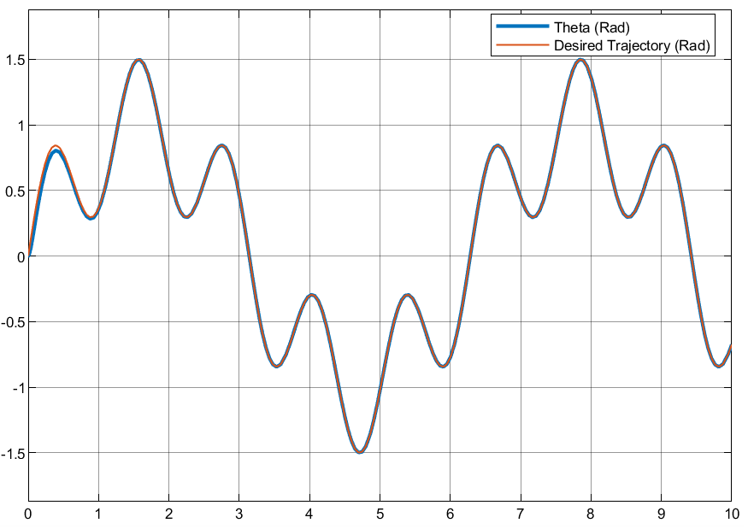
Key Results 1: 100% Patient Effort
4

Slide 6
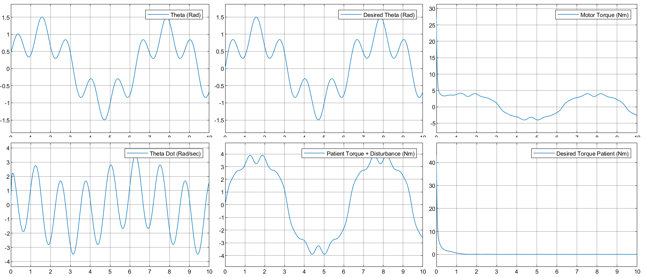
Key Results 1: 100% Patient Effort
5

Slide 7
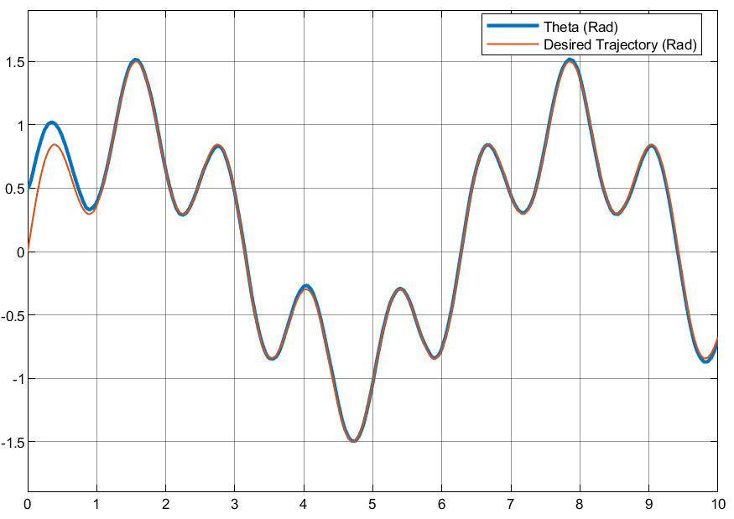
Key Results 1: 100% Patient Effort with disturbances added in Patient Torque
6

Slide 8
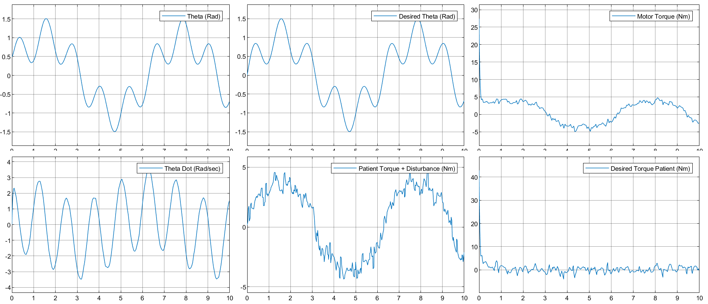
Key Results 1: 100% Patient Effort + disturbances in Patient Torque
7

Slide 9

Rationale / Approach / Ideas:
Control Law of Exoskeleton (0% Patient Effort):
For this mode, patient is applying zero torque and controller is compensating for dynamics of exoskeleton and limb.
Error Dynamics:
The error dynamics tries to compensate for the error between the desired and the patient angle.
Estimation of Patient Effort:
After the experiment, we have data of resultant limb motion and applied motor torque. Using them, we can estimate patient effort using system equation.
8

Slide 10
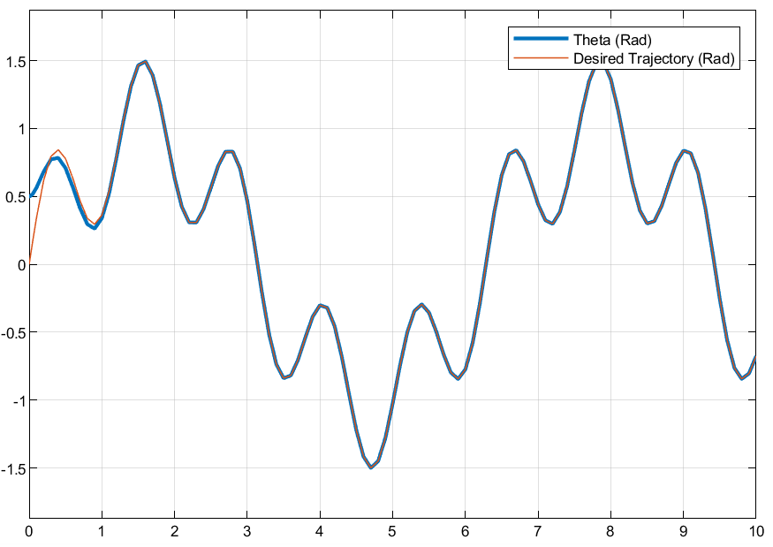
Key Results 2: 0% Patient Effort
9

Slide 11
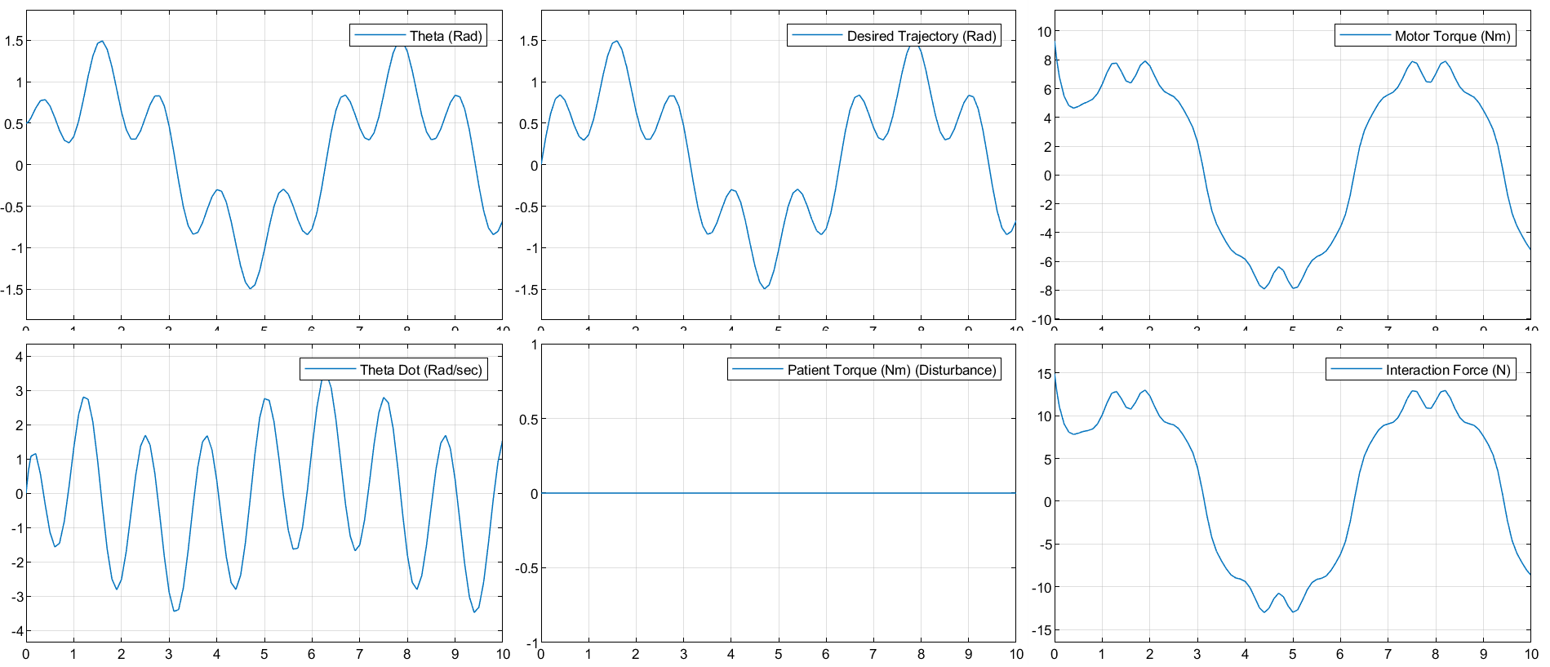
Key Results 2: 0% Patient Effort
10

Slide 12
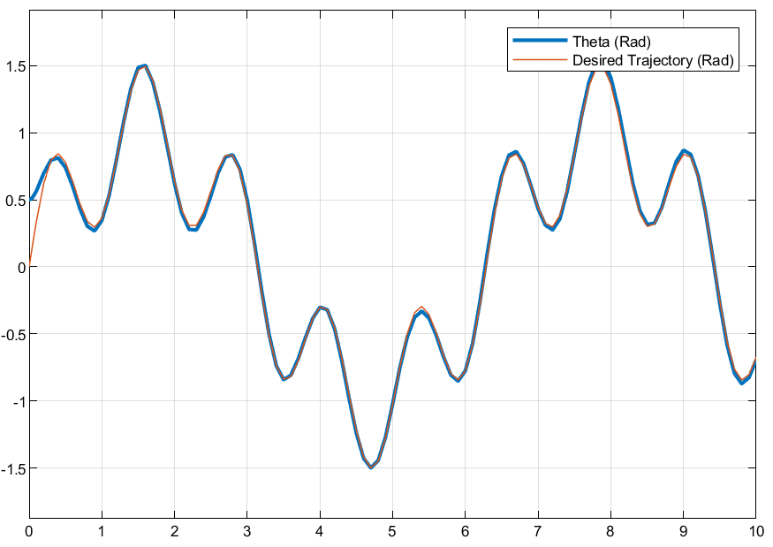
Key Results 2: 0% Patient Effort + disturbances in Patient Torque
11

Slide 13
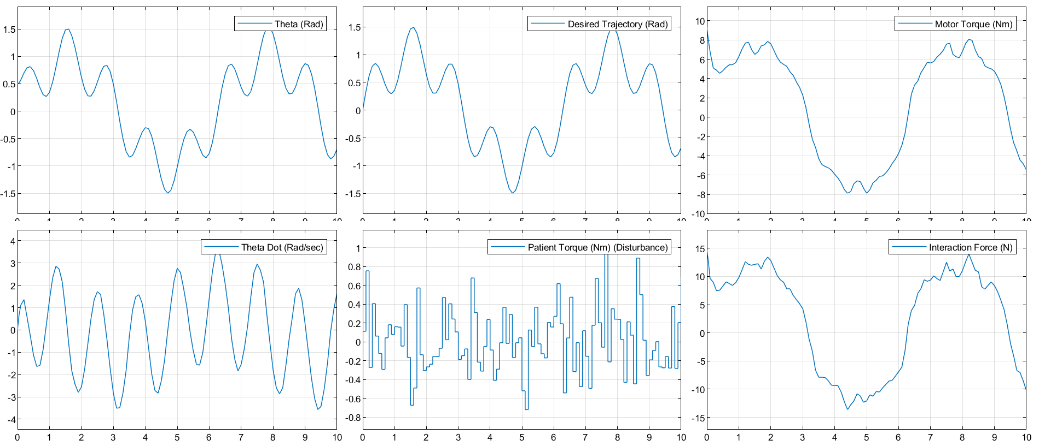
Key Results 2: 0% Patient Effort + disturbances in Patient Torque
12

Slide 14
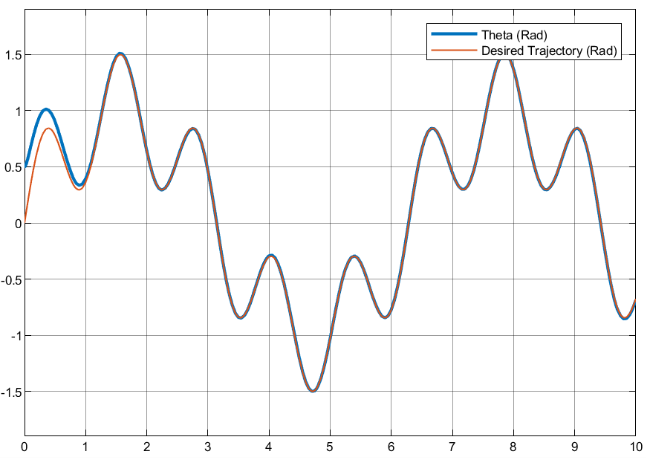
Key Results 3: 50% Patient Effort + disturbances in Patient Torque
13

Slide 15
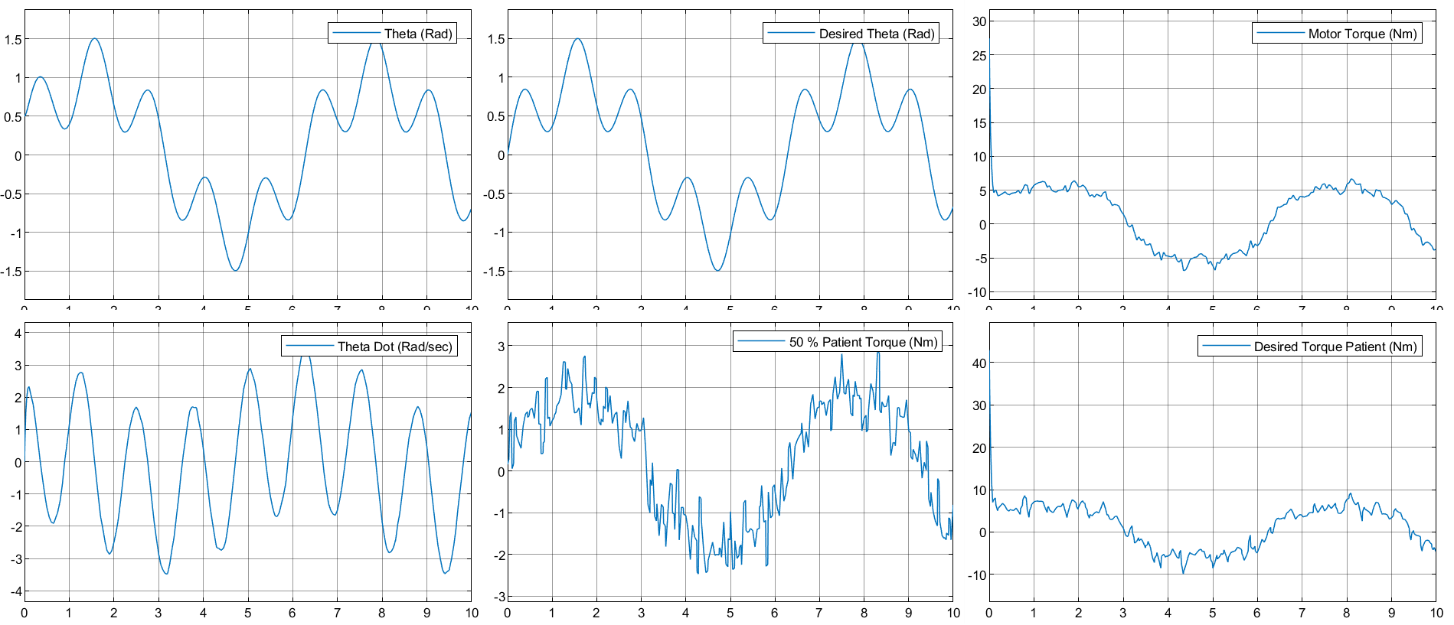
Key Results 3: 50% Patient Effort + disturbances in Patient Torque
14

Slide 16
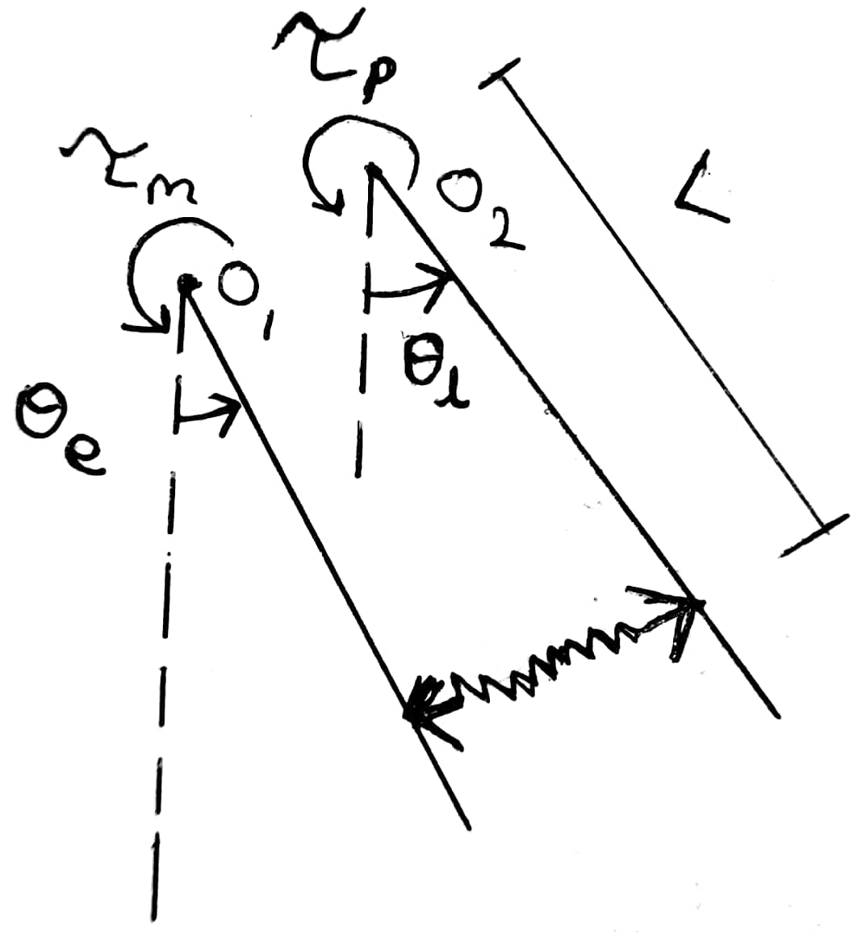

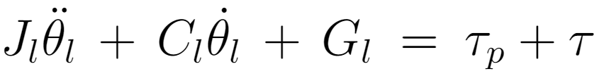
A Second Approach:
Modelling the 1-DOF Knee Joint-Shank System coupled via an Elastic link.
In reality, the straps & links used in exoskeletons are not rigid, but have certain stiffness associated with it.
To account for this in the model, we can consider limb and exoskeleton as two links joint together by an elastic link, with stiffness K.
Interaction force & patient effort are denoted as the same.
Θ_{e} and Θ_{l} denotes the position of exoskeleton link and limb respectively.
Equations:
Equation of motion for exoskeleton link:
Equation of motion for limb:
15

Slide 17
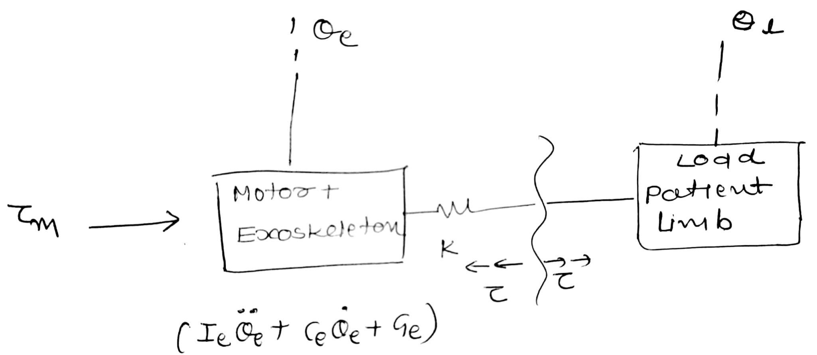
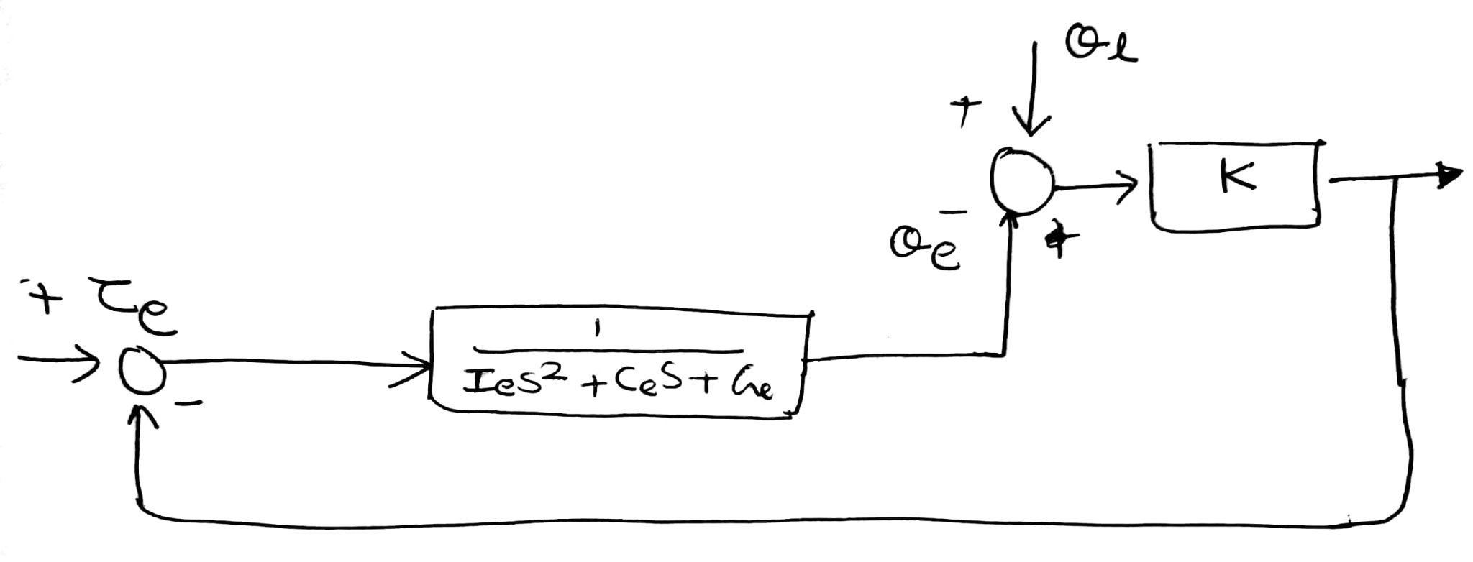
Control - Second Approach:
16

Slide 18
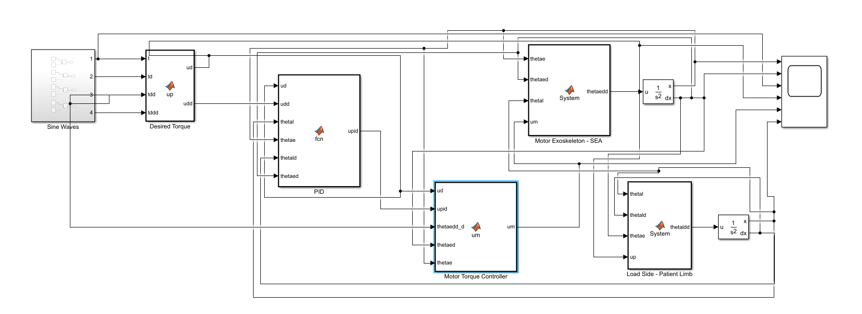
Control - Second Approach:
17

Slide 19
Future work:
The controller can be improved.
SEA approach is one of the way to go ahead and Torque control is needed.
Thank You!
18

Slide 20
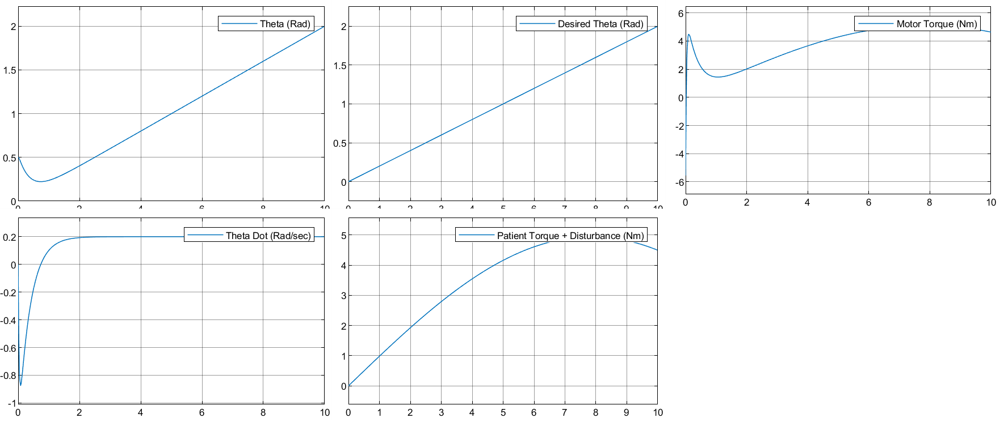
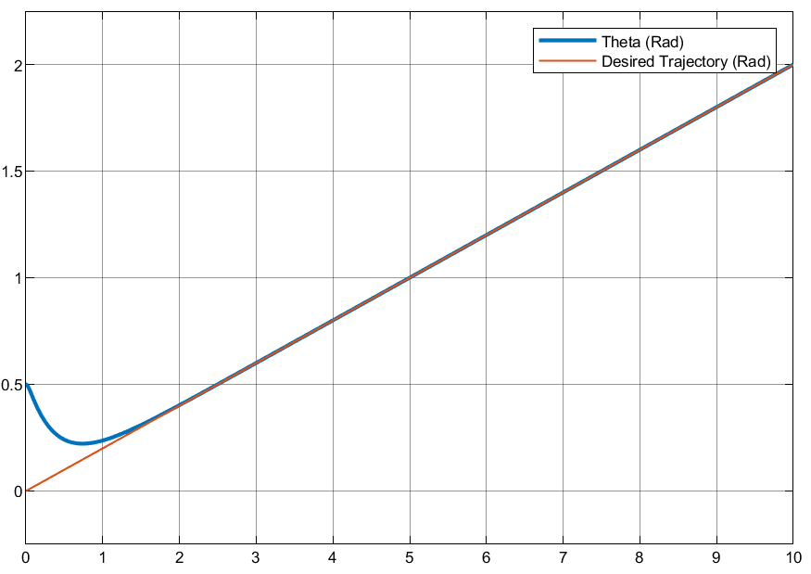
Additional results 1: 0% Patient Effort, Linear Trajectory
19

Slide 21
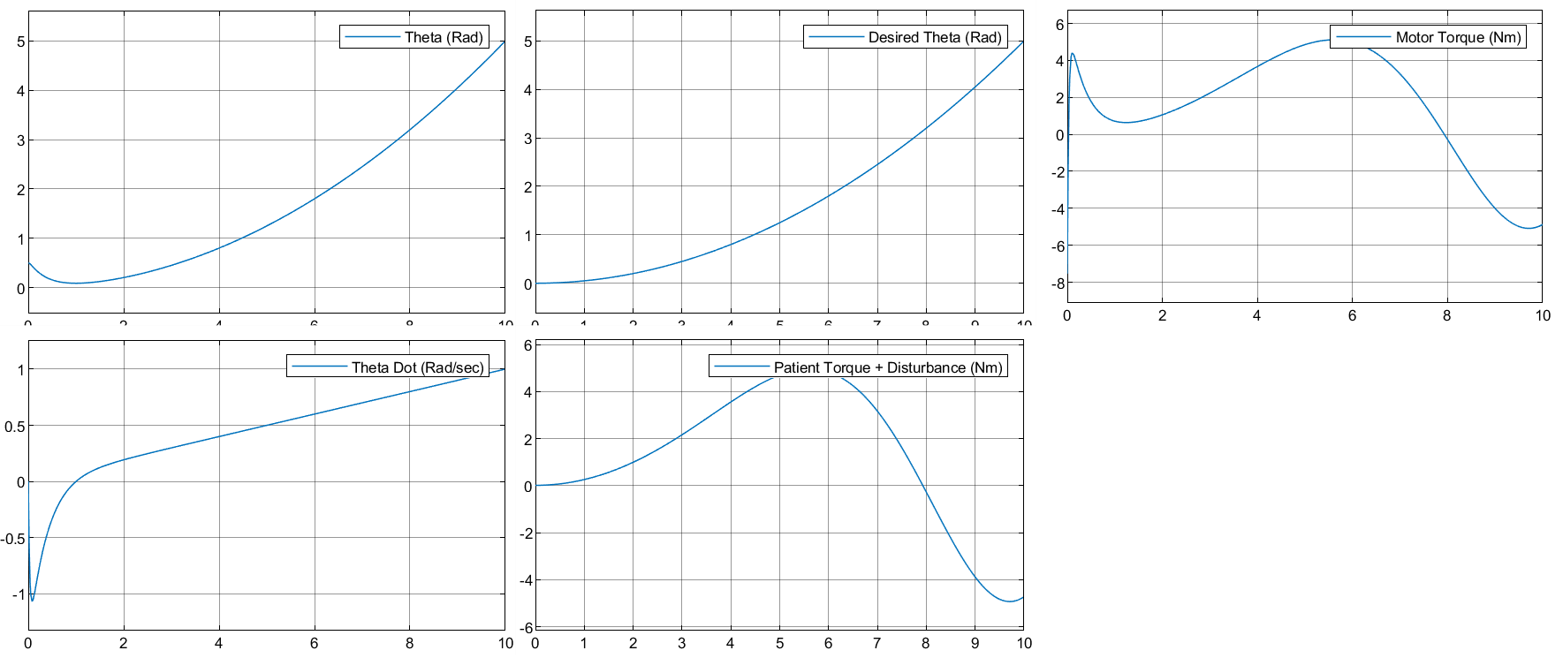
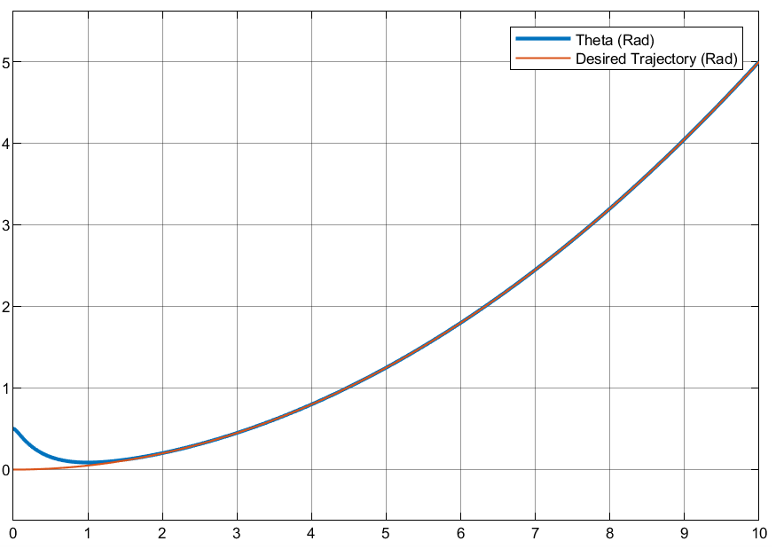
Additional results 2: 100% Patient Effort, Parabolic Trajectory
20

